Slide 1


Lecture 16:
Final Remarks
CoTaPP: Computational Thinking and
Programming with Python
All icons by: https://www.flaticon.com/

Slide 2

Today’s lecture
Summary of the course
Q&A
What is next?
Administrative aspects

Slide 3
Announcements
Missing final (sickness, force majeur)
Final exam information on Blackboard

Slide 4
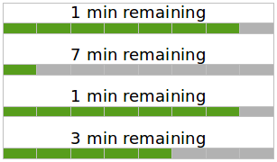
Lecture 1: Computational Thinking
How many minutes
will it take until all 4 ﬁles have ﬁnished downloading?

Slide 5
Lecture 1: Computational Thinking
After 1 min
6
2
How many minutes
will it take until all 4 ﬁles have ﬁnished downloading?

Slide 6
Lecture 1: Computational Thinking
After 1 min
3
6
1
2
How many minutes
will it take until all 4 ﬁles have ﬁnished downloading?

Slide 7
Lecture 1: Computational Thinking
After 1 min
After 2 min
3
6
2
3
1
2
1
How many minutes
will it take until all 4 ﬁles have ﬁnished downloading?

Slide 8
Lecture 1: Computational Thinking
After 1 min
After 2 min
3
6
1
2
3
1
2
1
How many minutes
will it take until all 4 ﬁles have ﬁnished downloading?

Slide 9
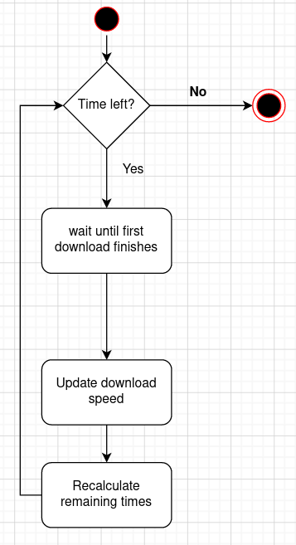

Lecture 2: Activity Diagrams

Slide 10
Lecture 3: Getting started with Python
print(‘1 min remaining’)

Slide 11
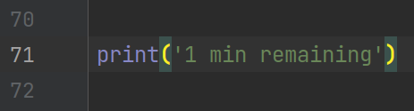
Lecture 3: Getting started with Python
print(‘1 min remaining’)

Slide 12


Lecture 3: Getting started with Python
print(‘1 min remaining’)

Slide 13
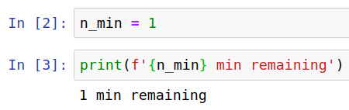
Lecture 3: Getting started with Python
print(‘1 min remaining’)

Slide 14

Lecture 3: Getting started with Python
print(‘1 min remaining’)

Slide 15
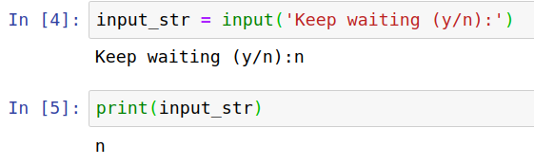
Lecture 3: Getting started with Python
print(‘1 min remaining’)

Slide 16
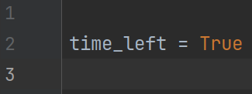
Lecture 4: Boolean expressions and conditional branching

Slide 17
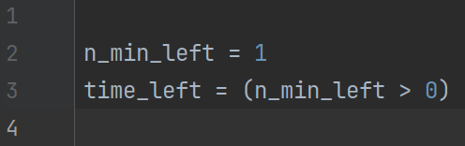
Lecture 4: Boolean expressions and conditional branching

Slide 18
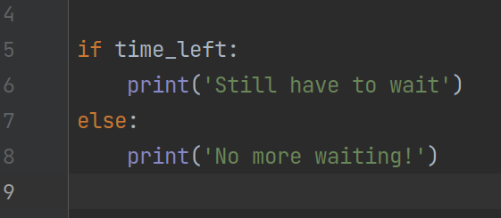
Lecture 4: Boolean expressions and conditional branching

Slide 19
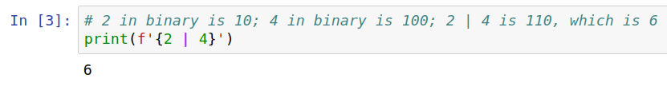
Lecture 4: Boolean expressions and conditional branching

Slide 20
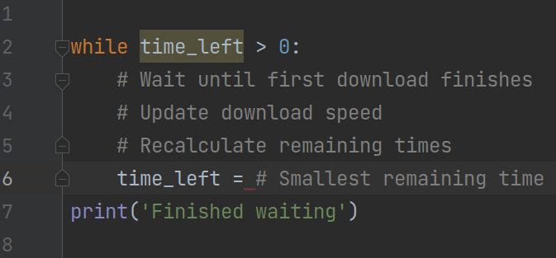
Lecture 5: Loops

Slide 21
Lecture 5: Loops
break
continue
for
Testing
Debugging

Slide 22
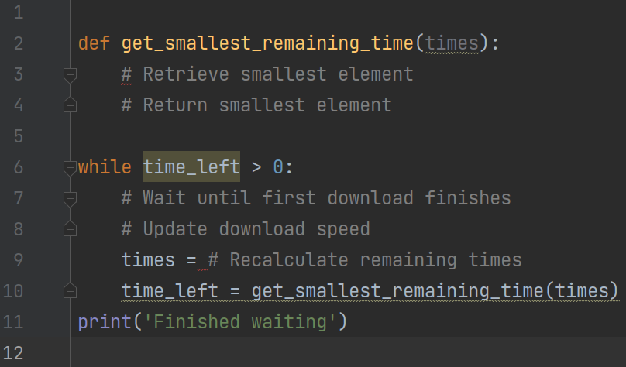
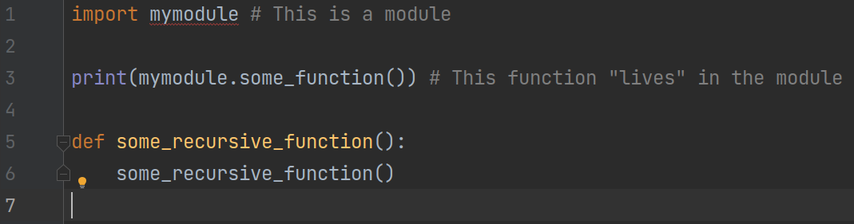
Lecture 6: Functions

Slide 23
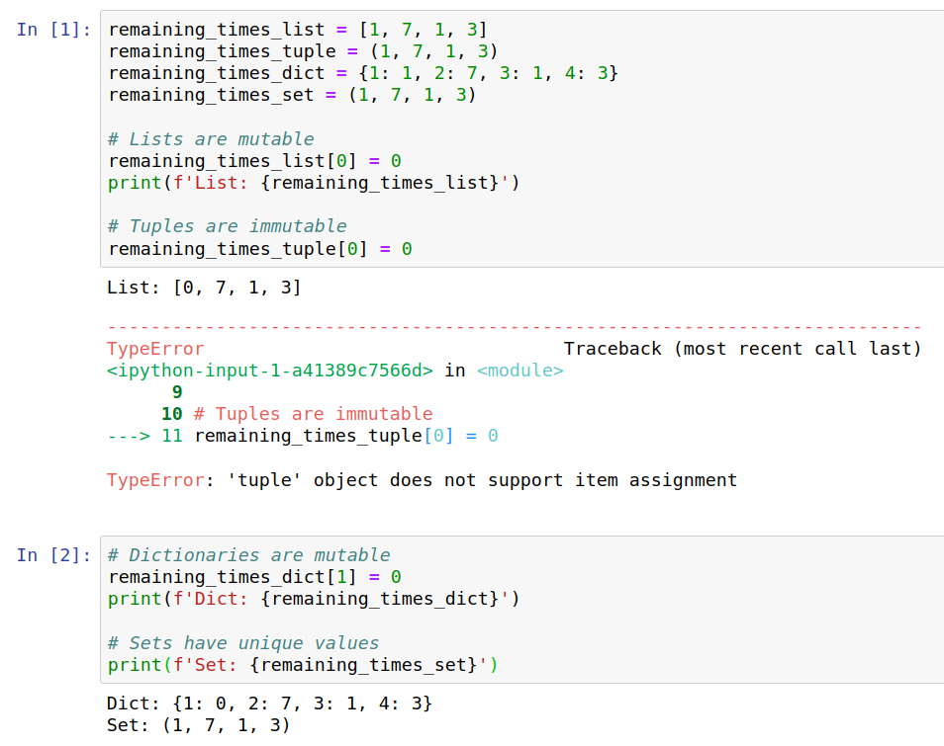
Lecture 7: Data Structures

Slide 24
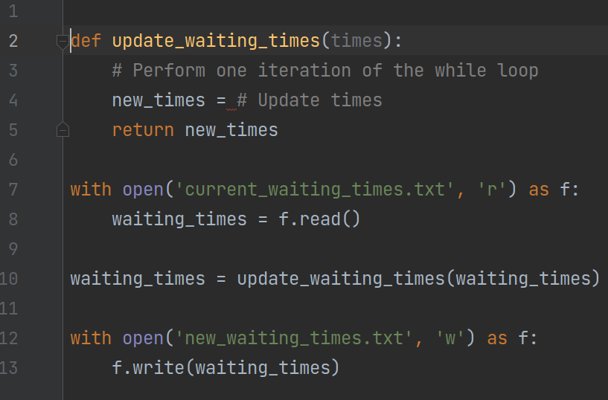
Lecture 8: File I/O

Slide 25
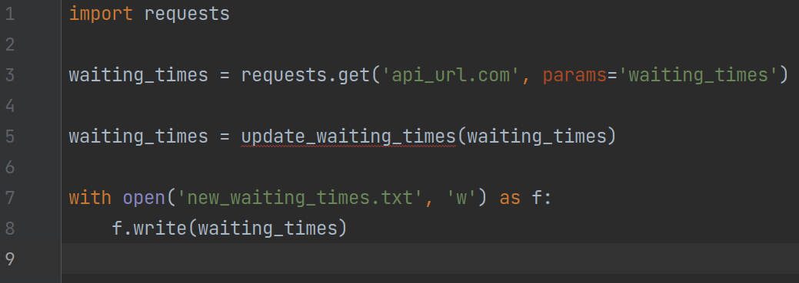
Lecture 9: Accessing Remote Resources

Slide 26
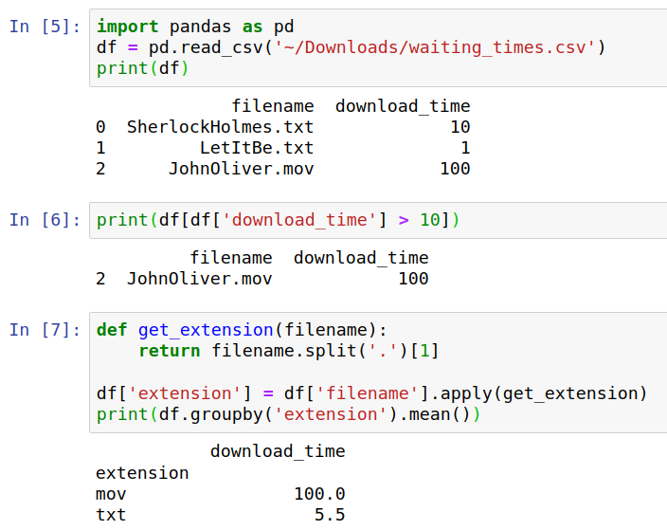
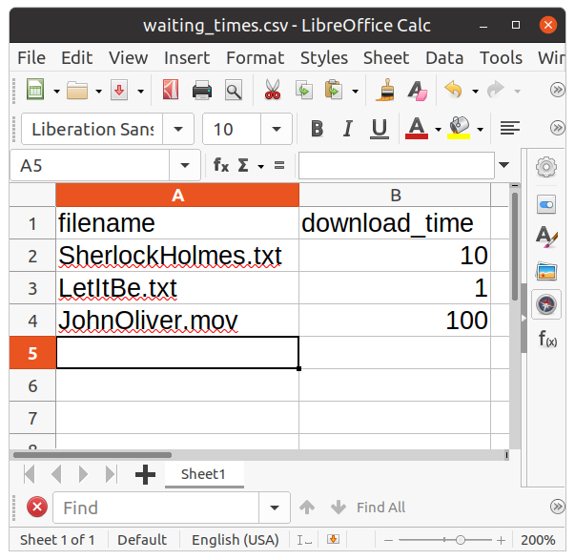
Lecture 10: Data Science

Slide 27
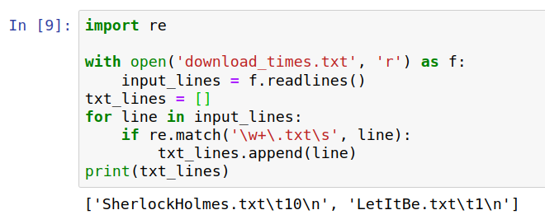

Lecture 11: Regular Expressions

Slide 28
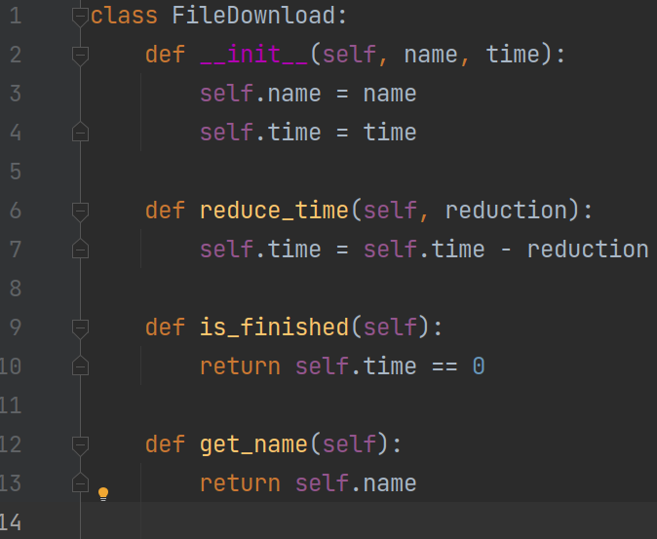
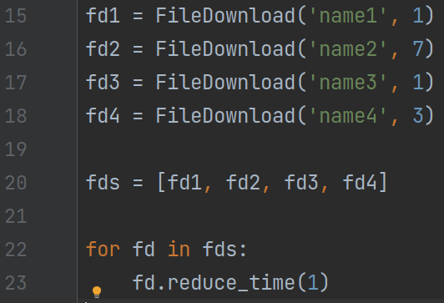
Lecture 12: OOP

Slide 29
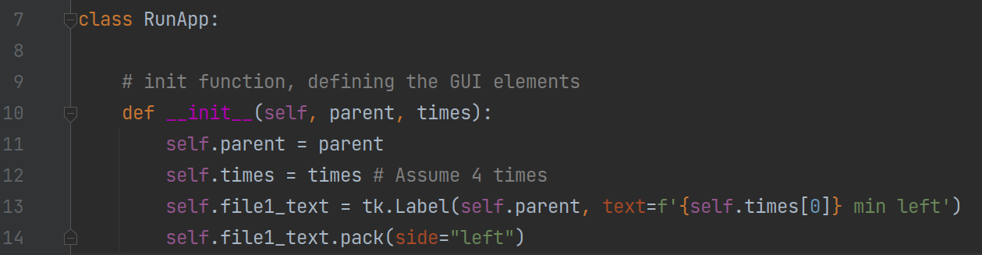
Lecture 13: Graphical Interfaces

Slide 30
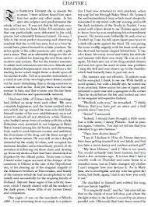








Lecture 14: Parallel Programming
Longest word
Most frequent word
Number of palindromes

Slide 31
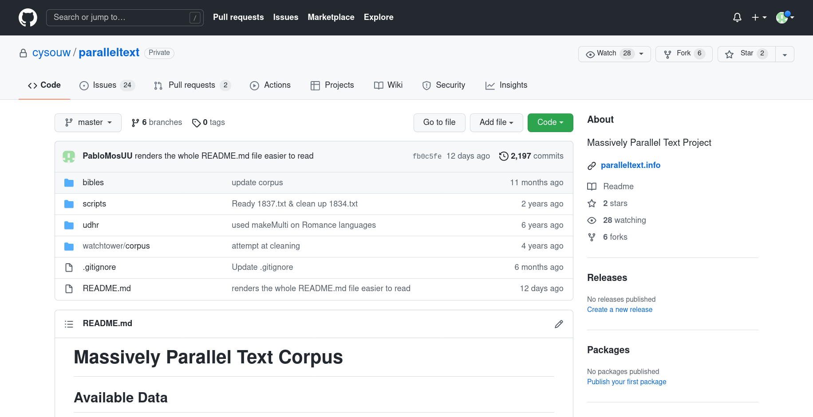
Lecture 15: Open Science

Slide 32
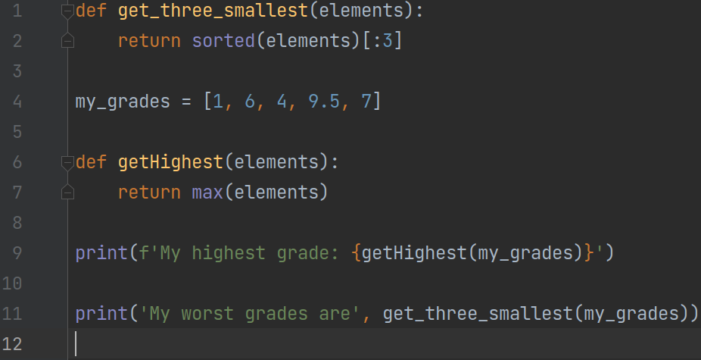
Lecture 16: Code Quality

Slide 33
What is next?

Slide 34
Administrative Aspects
Course Evaluation in Caracal
  Open till till 4/24/2022 11:00:00 PM
  Your comments help us to improve the course!
  Visit https://caracal.uu.nl/

Slide 35
Administrative Aspects
Final Exam
  Wednesday, April 13th, 2022
  17:00-20:00 (+30 min for students qualifying for extra time)
  EDUC-THEATRON
  You will work on your own laptop
  Details → Blackboard → Course Information → Final Exam Information

Slide 36
Administrative Aspects
Project 4
  Deadline: 19th April, 13:00
Final grades
  03rd May

Slide 37
Administrative Aspects
Retake
  Deadline: 06th July, 13:00

